Slide 1

CS-130
Legal Issues in Computing -
Professionalism in Computing

Slide 2

Learning Goals
What is professionalism in Computing?
Who are the major professional bodies in computing and what are their codes of conduct about?
Why does it matter that we are professional as a collective?
What issues exist around equal access in computing?
What are the practical and ethical considerations when thinking about Public Interest Disclosures (whistleblowing)?
Notes:
Tran – violating this requires some form of eavesdropping…..

Slide 3
What do you understand professional behaviour to be?
Notes:
5 minutes
Not just a suit and tie
Code of conduct
TRAN: Before specifics, why is it so important

Slide 4
Why Behave Professionally?
We (Computer Scientists) are judged internally (invisibly) by it as individuals
All members of a group (including you) are judged by outsiders
Professional behaviour enhances prestige of group, and you by association
Doctors and lawyers are well respected in society
Current standing of journalists and politicians are a decent counter example
Notes:
People do it regardless of whether they know the code of conduct
Prestige… why? About people listening
TRAN: so what

Slide 5
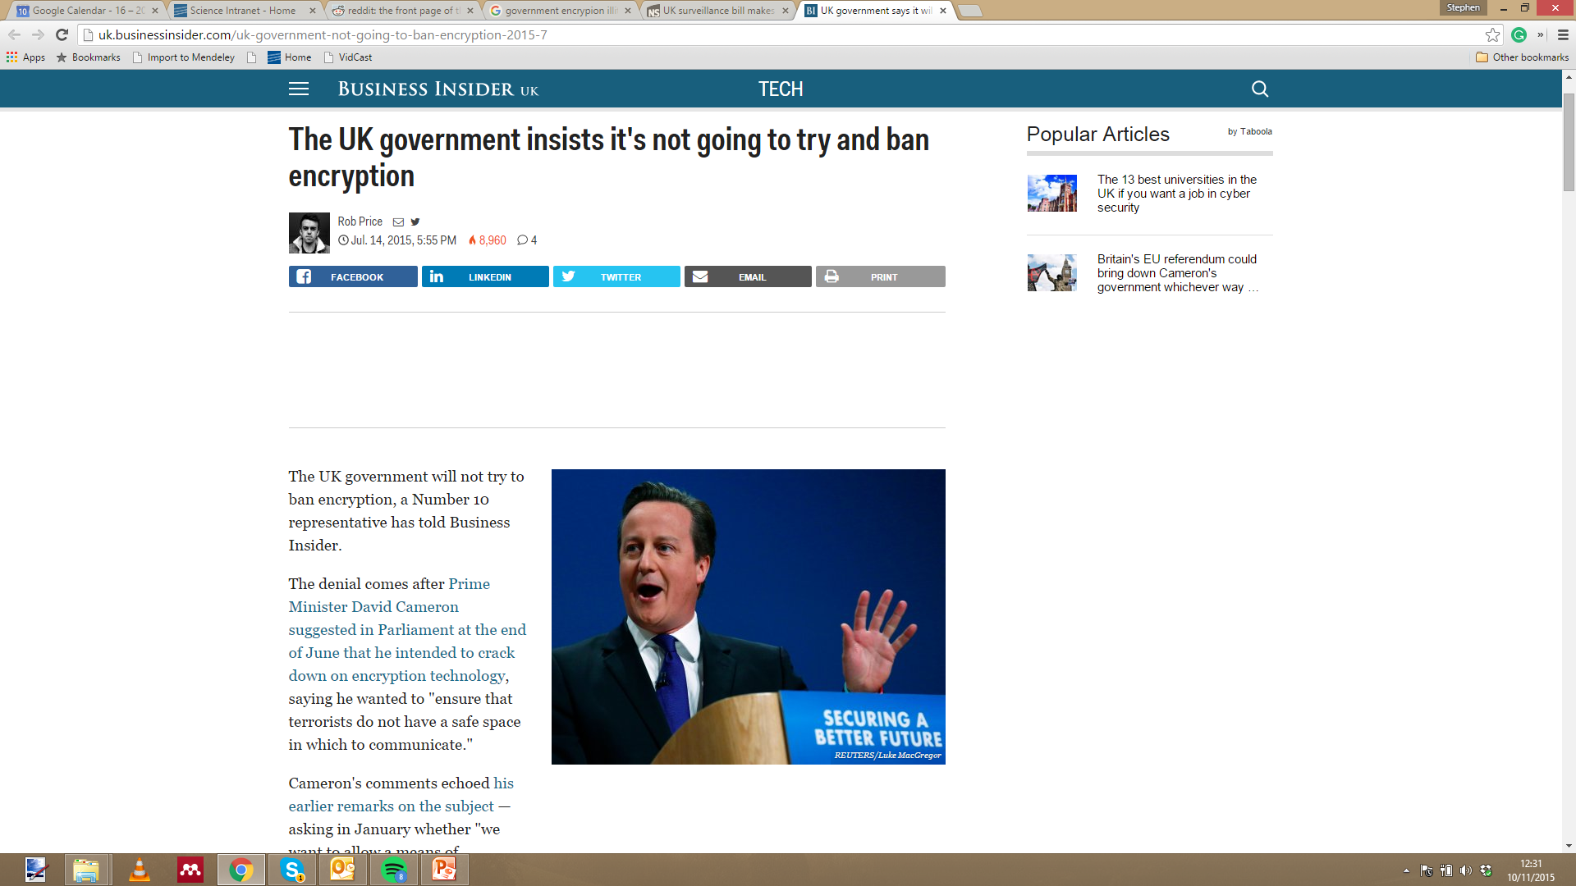

Slide 6
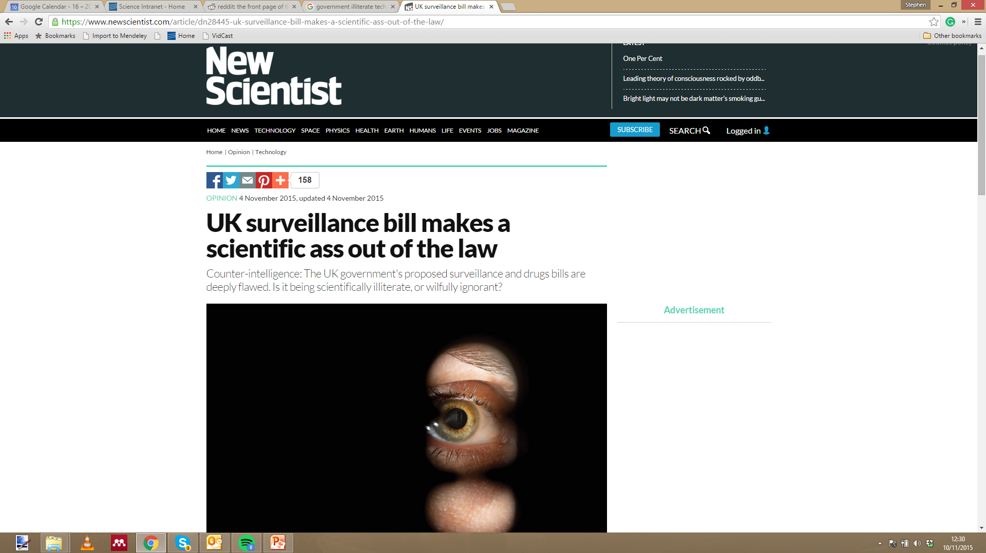

Slide 7
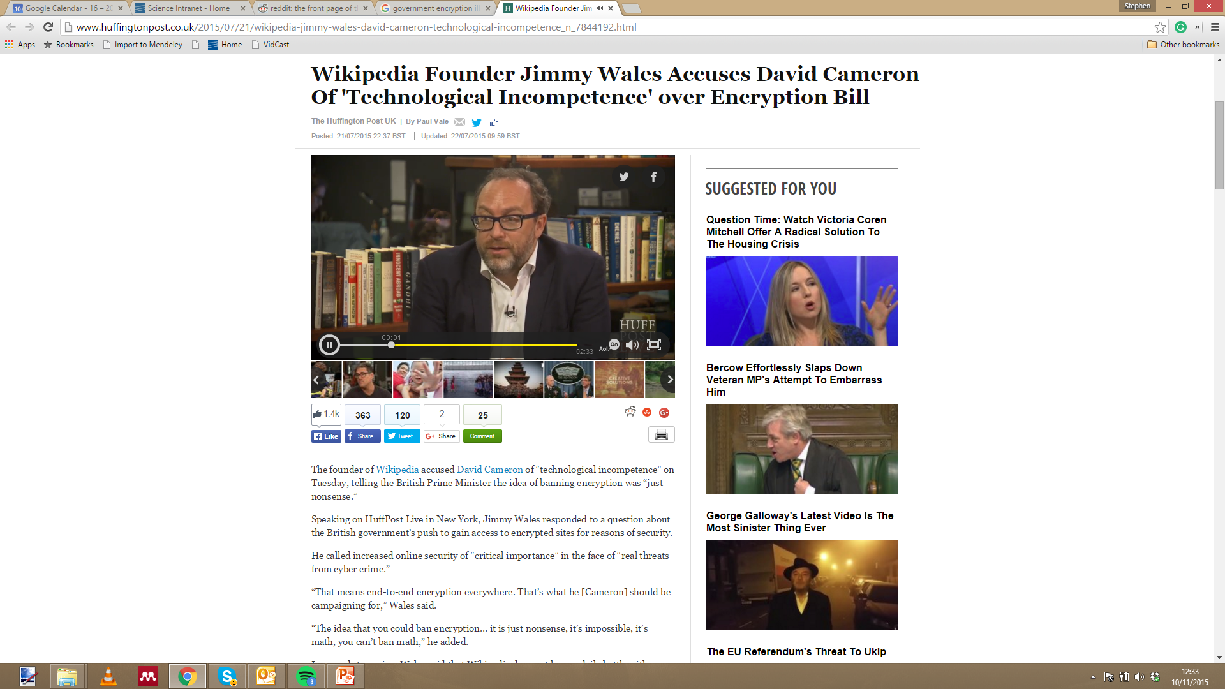

Slide 8
Professional Bodies
UK: British Computer Society (BCS)
US: Association for Computing Machinery (ACM)
Institute of Electrical and Electronics Engineers (IEEE)
Bodies provide a range of benefits to members
Databases of papers and (surprisingly good) professional magazines
Training courses
Conferences
Some employees insist on having, and maintaining, membership
Notes:
Its like joining a cult!
Benefits such as publications, training, letters after your name….

Slide 9
What does, and doesn’t it involve?
You do not take responsibility for things over which you have no control
You must recognise where you do and do not have control and influence
You don’t need to be selfless and abandon self-interest
You must weigh up personal gain against effects on others within and outside immediate circumstances

Slide 10
BCS – Interesting Bits
This code of conduct:
Sets out the professional standards required by BCS as a condition of membership
Applies to all members, irrespective of their membership grade, the role they fulfil, or the jurisdiction where they are employed or discharge their contractual obligations
Governs the conduct of the individual, not the nature of the business or ethics or any Relevant Authority rules
Notes:
It really is like joining a cult

Slide 11
Why would a job want you to be a member of a professional body?
Notes:
20

Slide 12
Professional membership and jobs
Some jobs ask that applicants be a member of a professional body in order to
Ensure you have no serious criminal convictions
Ensure you can be trusted to behave professionally
Show that you are engaged with the subject area and aim to continue growing your skills

Slide 13
From the BCS: Competence and Integrity
You shall:
a. only undertake to do work or provide a service that is within your professional competence
b. NOT claim any level of competence that you do not possess.
c. develop your professional knowledge, skills and competence on a continuing basis, maintaining awareness of technological developments, procedures, and standards that are relevant to your field.
d. ensure that you have the knowledge and understanding of Legislation and that you comply with such Legislation, in carrying out your professional responsibilities.
f. avoid injuring others, their property, reputation, or employment by false or malicious or negligent action or inaction
Notes:
25 mins
TRAN: But beyond this

Slide 14
Good Conduct
More than just following the rules, this is about being a good citizen
A major theme in all professional bodies material
It goes beyond honest and trustworthy work and demands that you give consideration to the consequences of your actions
The opposite of a “caveat emptor” attitude
The benefit is a more broadly respectful society
Think back to quotes in the opening lecture from lawmakers dismissing “geeks” – would they dismiss lawyers or doctors?

Slide 15
From the BCS: Public Interest
You shall:
a. have due regard for public health, privacy, security and wellbeing of others and the environment
b. have due regard for the legitimate rights of Third Parties
c. conduct your professional activities without discrimination on the grounds of sex, sexual orientation, marital status, nationality, colour, race, ethnic origin, religion, age or disability, or of any other condition or requirement
d. promote equal access to the benefits of IT and seek to promote the inclusion of all sectors in society wherever opportunities arise
Notes:
TRAN.. Theres an obvious public interest thing to discuss here….

Slide 16
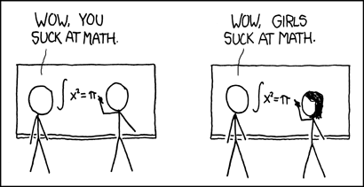

Slide 17
Promoting Equal Access in Computing
Why is computing as a field homogenous?
Discouragement systematic after the age of 12 (TechnoCamps work at Swansea supports this!)
Lack of role models in the field an issue for some
Cultural attitudes are still an issue in some work places
Some common misconceptions
Men are genetically better at it – not supported by grade averages or blind competence tests (but supported by non-blind ones which is an issue…)
Women don’t like computers – only after the age of 12 does this creep in
Positive discrimination in hiring – this is illegal in the UK but targeted job advertisement is legal
Notes:
TRAN.. Theres an obvious public interest thing to discuss here….

Slide 18
Public Interest and The Public Interest Disclosure Act 1998: “Whistle Blowing”
Breaking a contract’s non-disclosure agreement to show bad behaviour is called whistleblowing
You an use a Public Interest defence in court if you are sued for doing this i.e. it was done with the welfare of the general public in mind
You cannot be sued (successfully) for reporting crimes to the police
PIDA1998 is Designed to protect you from repercussions from employers through employment contracts or otherwise if you disclose illegal or dangerous behaviour
Disclosure might be done through the press (anonymously) with Public Interest is different to PIDA
Other ways – Social media, blogs, FB, Twitter etc. Risk of revealing identity.

Slide 19
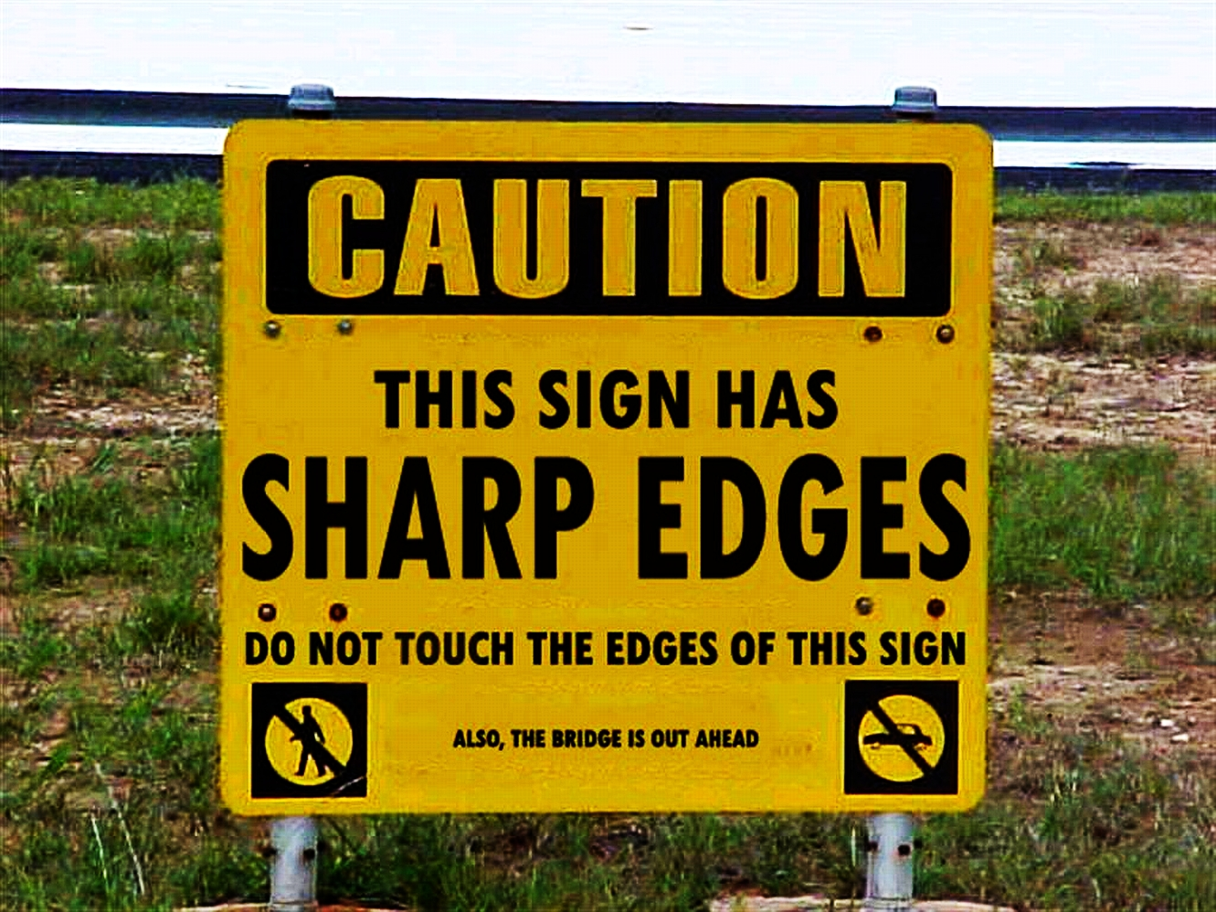
Health and safety….
Of course this isn’t hat you were expecting but actually
Notes:
31

Slide 20
Public Interest Disclosure: Health and safety
One of the simplest examples of the necessity of whistleblowing or speaking out in the work place
Health and safety is still relevant to your daily life!
Maybe you think it’s excessive now
Media and public perception
How dangerous were workplaces before the advent of health and safety legislation and nationalised healthcare?
Notes:
Tell story about teeth

Slide 21
Showing due care and diligence
Probably your best defence if things are escalated
Show how you have acted following a professional body’s Code of Conduct
But still, whistleblowing often comes with a cost…

Slide 22
Case Study 1 – Brett McDanel
Employed at Tornado Development Inc, an ISP which offered “secure” web mail
Discovered it wasn’t secure and reported to employers
Left, and after six months discovered flaws hadn’t been fixed
Emailed 5,500 users and directed them to his website
ISP deleted emails (without users’ permission) and made criminal complaint
Notes:
No pretense at being for anything other than the disclosure of the information harming the company

Slide 23
Case Study 2 – Katherine Gunn
A UK Government civil servant, translating at GCHQ Cheltenham asked to translate diplomatic bugging for the NSA
Reported to the press that UN Security Council members were being bugged (with the intent of ensuring support for the Iraq War)
Bugging illegal under UN Vienna Conventions
Notes:
No pretense at being for anything other than the disclosure of the information harming the company

Slide 24
Results
McDanel convicted, spent time in jail
Appealed after release – conviction overturned
The government charged and convicted McDanel under the theory that the e-mailed warning itself violated the antihacking Computer Fraud and Abuse Act because it “impaired the integrity” of the vulnerable system.
Gunn sacked and prosecuted under the Official Secrets Act
Charges dropped at the start of the trial
Some suggestion that this was only because of clever work by her defence team that would have forced more sensitive data into the public domain

Slide 25
What can you do in order to show due care and
diligence?
Notes:
43
Self interest? Does it go against this?

Slide 26
Learning Goals
What is professionalism in Computing?
Who are the major professional bodies in computing and what are their codes of conduct about?
Why does it matter that we are professional as a collective?
What issues exist around equal access in computing?
What are the practical and ethical considerations when thinking about Public Interest Disclosures (whistleblowing)?
Notes:
Tran – violating this requires some form of eavesdropping…..

